Slide 1

Federated ML Sys for Fairness
10/27/22
Jade Preston & Navya Annapareddy
PhD Degree Program
School of Data Science
University of Virginia
Notes:
Jade

Slide 2
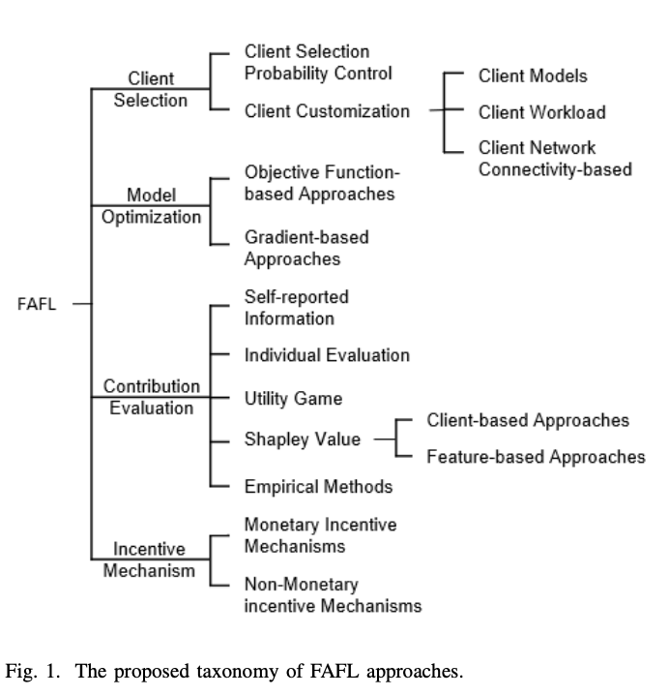
Review: Surveys on Fairness in Federated Learning
Towards Fairness-Aware Federated Learning, Shi et al. (2021)
Discuss ideal metrics but do not benchmark
Created FL taxonomy of approaches
Categorized fairness approaches
Accuracy Parity
Good Intent Fairness
Selection Fairness
Contribution Fairness
Regret Distribution Fairness
Expectation Fairness
Notes:
Navya
https://arxiv.org/pdf/2111.01872.pdf

Slide 3
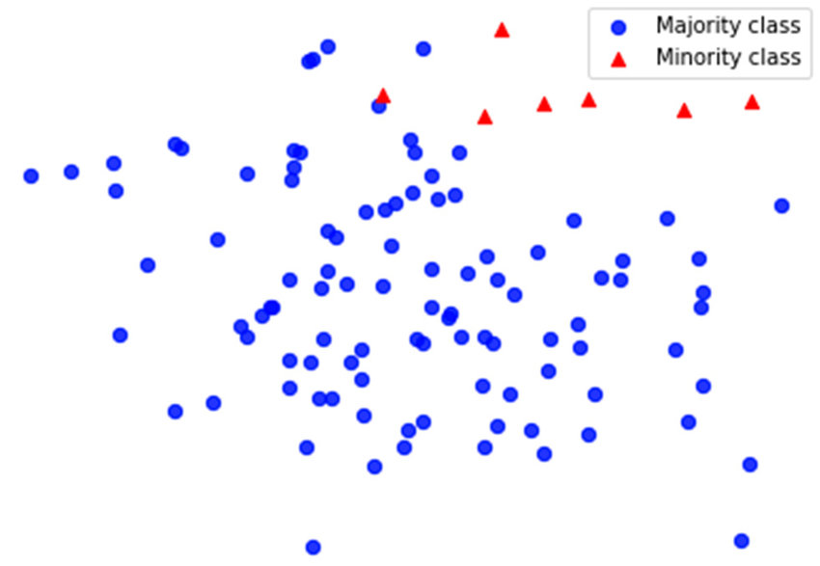
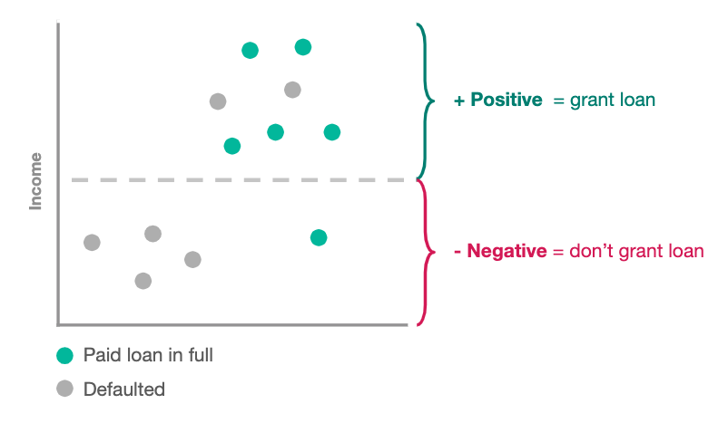
Review: Surveys on Fairness in Federated Learning
Survey on Fairness Aware Machine Learning, Quy et al. (2021)
Examines bias in federated learning datasets in different domains
Financial, Healthcare, Synthetic
Explored fairness challenges
Cardinality + imbalance
Independence
Identified fairness approaches
Multi-discrimination
Temporal fairness
Distributional fairness
Notes:
Jade
https://arxiv.org/pdf/2110.00530.pdf

Slide 4
Implementation Papers | Approach | Metric
FedScale: Benchmarking Model and System Performance of Federated Learning at Scale | Contribution -> System Heterogeneity, Survey | Accuracy, Loss
Federated Learning on Clinical Benchmark Data: Performance Assessment | Accuracy | AUROC and F1
Fair Federated Learning via Bounded Group Loss | Accuracy | Custom Loss
Fairness and Accuracy in Federated Learning | Synthetic Dataset Fairness, Accuracy | Accuracy, Loss
A Reputation Mechanism Is All You Need: Collaborative Fairness and Adversarial Robustness in Federated Learning | Contribution Fairness, Selection Fairness | Pearson Correlation Coefficient
Ditto: Fair and Robust Federated Learning Through Personalization | Accuracy Parity | Accuracy, variance of robustness
Utility Fairness for the Differentially Private Federated Learning | Contribution -> System Heterogeneity | Accuracy; negative log likelihood loss
Resource Management and and Model Personalization for Federated Learning over Wireless Edge Networks | Accuracy | Accuracy, Loss

Slide 5
Implementation Papers (Con.) | Approach | Metric
Fairness and Accuracy in Horizontal Federated Learning | Synthetic Dataset Fairness, Accuracy | Accuracy, Loss
Fairness Aware Incentive Scheme for Federated Learning | Expectation -> Regret Distribution | Collective Utility
Agnostic Federated Learning | Good Intent | Agnostic Loss
Federated Optimization In Heterogeneous Networks | Contribution -> Personalization/Distributional | Accuracy, Loss
Fairness-aware Agnostic Federated Learning | Good Intent | Loss /w Fairness Constraint
Client Selection Scheme for Federated Learning with Fairness Guarantee | Selection | Accuracy
Fairness in Federated Learning for Spatial-Temporal Applications | Temporal | KL, Diversity Metric

Slide 6
References
https://arxiv.org/pdf/2110.00530.pdf
https://arxiv.org/pdf/2111.01872.pdf
https://arxiv.org/pdf/2105.11367.pdf
https://www.ncbi.nlm.nih.gov/pmc/articles/PMC7652692/
https://arxiv.org/pdf/2203.10190
https://arxiv.org/pdf/2012.10069
https://arxiv.org/pdf/2011.10464
http://proceedings.mlr.press/v139/li21h/li21h.pdf
https://arxiv.org/pdf/2109.05267
https://www.mdpi.com/2224-2708/10/1/17/pdf?version=1616039824
Notes:
Jade

Slide 7
Questions?

